Slide 1
Structural Holes & Brokerage

Slide 2
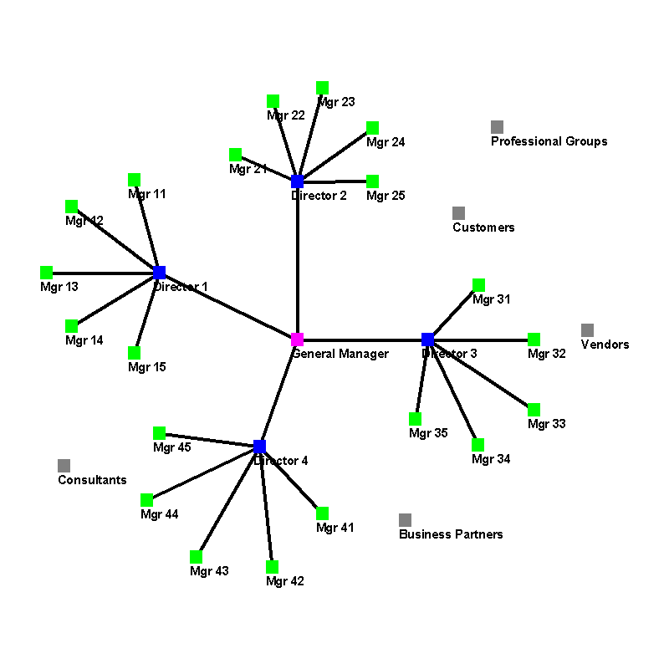
Triangles & Intermediation
From dyads to triads (Simmel)
  Introducing a third agent (person, organization)
Intermediation
  2-path connections through an intermediary
Shift focus from ego network to triads
Ego network clustering
  Redundancy: if information comes into your network you could obtain it from any of your alters
  Non redundant ego networks → structural holes → intermediation via alters
  Open networks lead to both opportunity to obtain more information/ideas AND more mediation in social relationships

Slide 3

Structural Holes & Weak Ties
Strong ties lead to triadic closure (SWT)
Communities of densely connected nodes with bridges between communities
Ego level
  Open vs. closed ego network
High ego network clustering coefficient leads to
  Redundancy
  Constraint
Structural holes -- two-paths that are not full triangles -- creates opportunities to “fill” the hole as an intermediary
Brokerage

Slide 4

Redundancy
When there is clustering, the effective size of a person’s network is lower than the observed size (degree centrality)
Consider the subgraph consisting only of the alters of an ego, along with the edges connecting them (i.e. remove ego from graph).
N = number of alters, i.e. degree of ego
M = number of edges among the N alters

Slide 5
Effective Size
N = 7, M = 6
Av. Degree = 2M/N = 2*6/7 = 1.7
CC = density = 2M/(N(N-1)) = (2*6)/(7*6) = .286
ES = N - (2M/N) = N - CC(N-1) = N - Av. D
  7-(2*6/7) = 7 - .286*6 = 7- 1.7 = 5.285
Efficiency = ES/N = 5.285/7 = .755
Reach Efficiency: ratio of 2-hop to 1-hop network

Slide 6
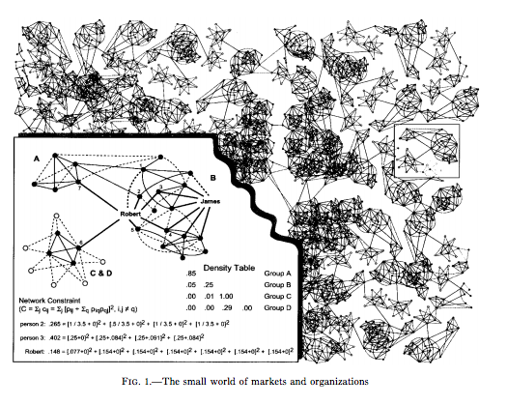
Constraint
From an ego’s perspective, how much is she a broker/intermediary
Constraint is the opposite of brokerage
  The more constrained, the fewer structural holes a person “fills”
3 “determinants” of constraint
  Network size
  Density
  hierarchy

Slide 7


Constraint
P_{ij} = m_{ij}/m_{i+} = 1/d_{j}
conditional probability that if j interacts with someone it will be with i
More constraint ego networks means that the person spans fewer structural holes
Constraint increases
Decreases in network size
CC (alters talk to each other a lot)
Hierarchy ( alters convey information to ego via other alters)

Slide 8
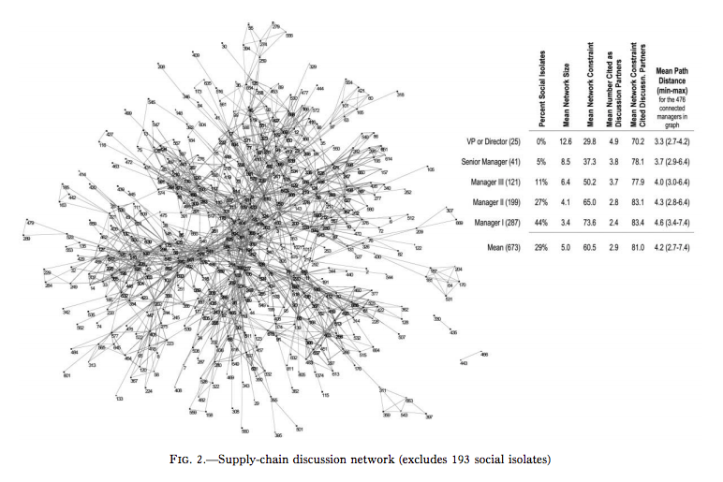
Network Constraint by Hierarchical Level
The higher the rank the
less constrained
larger their networks
Shorter the distance to all other managers
More citations (selection as discussion partner by other managers)
More constrained their discussion partners are

Slide 9
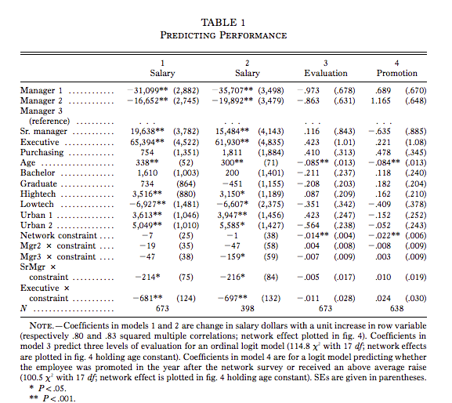
Effects of Constraint on Rewards
Constraint effects measures as negative returns to constraint on some positive outcome (slopes)
Constraint parameterized as slope adjustments to “baseline” rate of first-level managers
Findings
  Variation in constraint does not affect very much salary of lower and middle-levels managers
  But among senior managers and executives, the more constrained the less they makes
  More constrained managers have lower evaluations and lower promotion rates

Slide 10
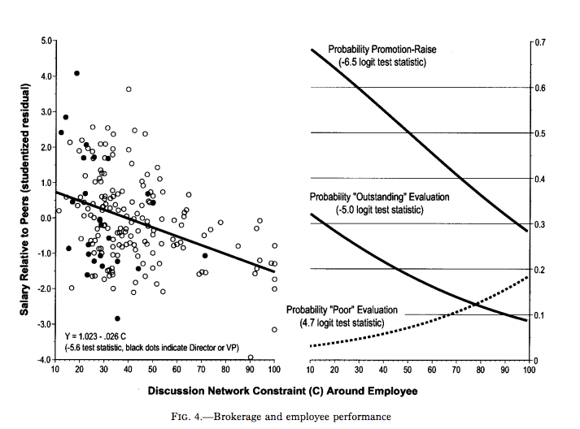
Findings
Variation in constraint does not affect very much salary of lower and middle-levels managers
But among senior managers and executives, the more constrained the less they makes
More constrained managers have lower evaluations and lower promotion rates

Slide 11
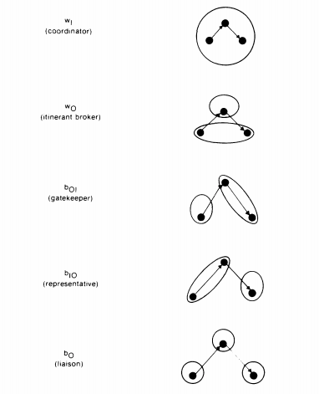
Types of Brokerage
Group nodes by groups
Brokerage can be within a group or between groups
Within-group brokers
  Coordinators: brings together two persons within a group who would not otherwise be connected. Coordinator is also part of the group.
  Itinerant Broker (consultant): same as coordinator but broker is not in the same group
Between-Group brokers
  Gatekeeper: grants access to someone in the brokers group to someone outside the group
  Representative: Broker connects people in her group to outsiders
  Liaison: All three actors in different groups

Slide 12
Measuring Brokerage Type
Computes measure of brokerage of each type for each agent (person, organization)
Total brokerage, sum of brokerage type measures
Compute individual measures by counting the number of triads of each type
Normalize by taking into account possibility of counts occurring by random matching
Need to sort nodes into groups

Slide 13
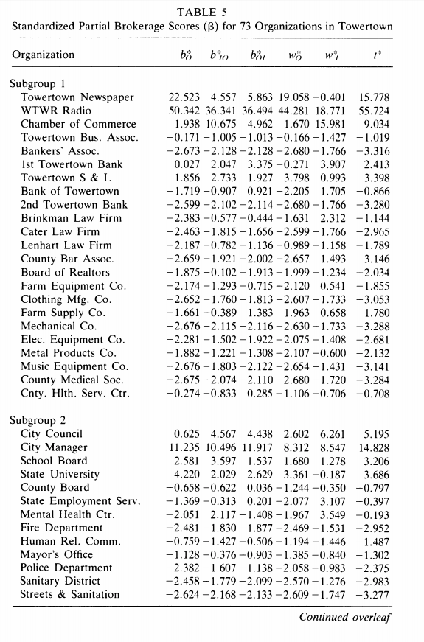
Brokerage Scores
73 organizations divided into 3 groups: businesses, government, non-profit
While for over half of organizations brokerage levels below what we would expect by chance, a few have very high brokerage scores → not a random network.
Radio station highest brokerage level and for of all types
Newspaper next highest, but not as a coordinator (i.e. not in the same group)
Chamber of Commerce not as liason or consultant

Slide 14
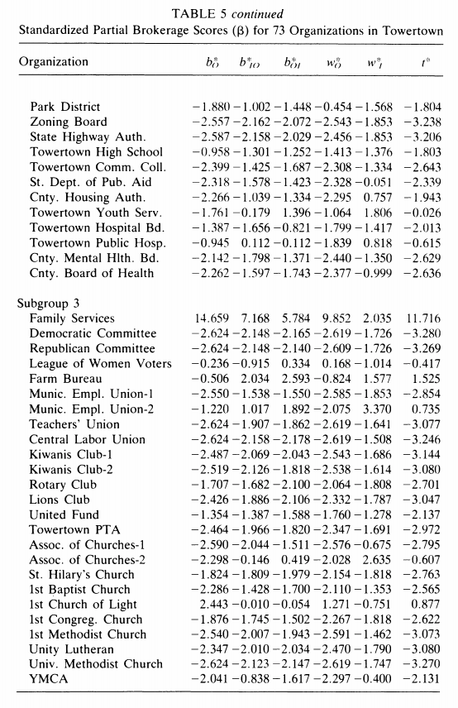
Brokerage Scores
73 organizations divided into 3 groups: businesses, government, non-profit
While for over half of organizations brokerage levels below what we would expect by chance, a few have very high brokerage scores → not a random network.
Radio station highest brokerage level and for of all types
Newspaper next highest, but not as a coordinator (i.e. not in the same group)
Chamber of Commerce not as liason or consultant
Municipal employees union #2 : overall not a broker, though it is more likely than chance to be coordinator within its sector (which includes other non-profit)

Slide 15
Structural Brokerage
Burt: Brokerage as not constrained, i.e. “spans” structural holes
  Not directional
  Function of network size, clustering and hierarchy
Gould and Fernandez: Brokerage as role played in a triangle
  Distinguish different brokerage (mediation) roles in terms of different structural network motifs
  Within and between group intermediation
  Within group brokerage -- bringing together people who are in the same group but not already connected
  Between group brokerage
    Representing group to outsider
    Gatekeeping for group with access by outsider
    Bringing together people from different groups who are not connected

Slide 16
Brokerage as Process
Obstfeld, Borgatti and Davis counter-examples to brokerage defined in terms of structural whole:
  Brokerage between 2 parties who already interact
    Brokers as “facilitors” within a dense network cluster
  Not necessarily brokerage when party connects two unconnected persons (i.e. a structural hole)
    Structural holes (2-paths) are opportunities for brokerage
    Brokerage requires not just opportunity, but motivation and action
3 forms brokering can take: Conduit, Tertius Gaudens, Tertius lungens

Slide 17
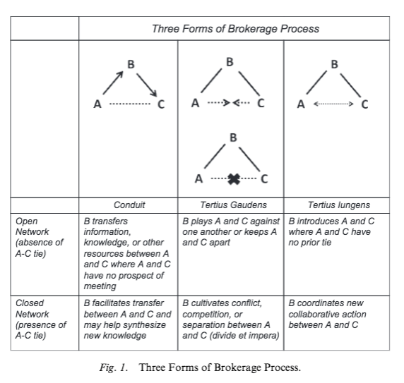
3 Brokerage Forms
Conduit forms: transferring information, ideas, solutions; analogous problem solving; synthesis
  Structural hole brokerage is conduit brokerage
  But can have conduit without a hole, ex: within group syntheses
Case of broker altering relationship between alters
  Tertius Gaudens: broker exploits alter-alter relationship by
    keeping disconnected
    encouraging conflict (divide and conquer)
  Tertius Lungens: broker connects (or facilitates interaction between) alters
    Can be by closing off a structural hole
    But can also be by coordinating interactions among those who are already connected

